Slide 1
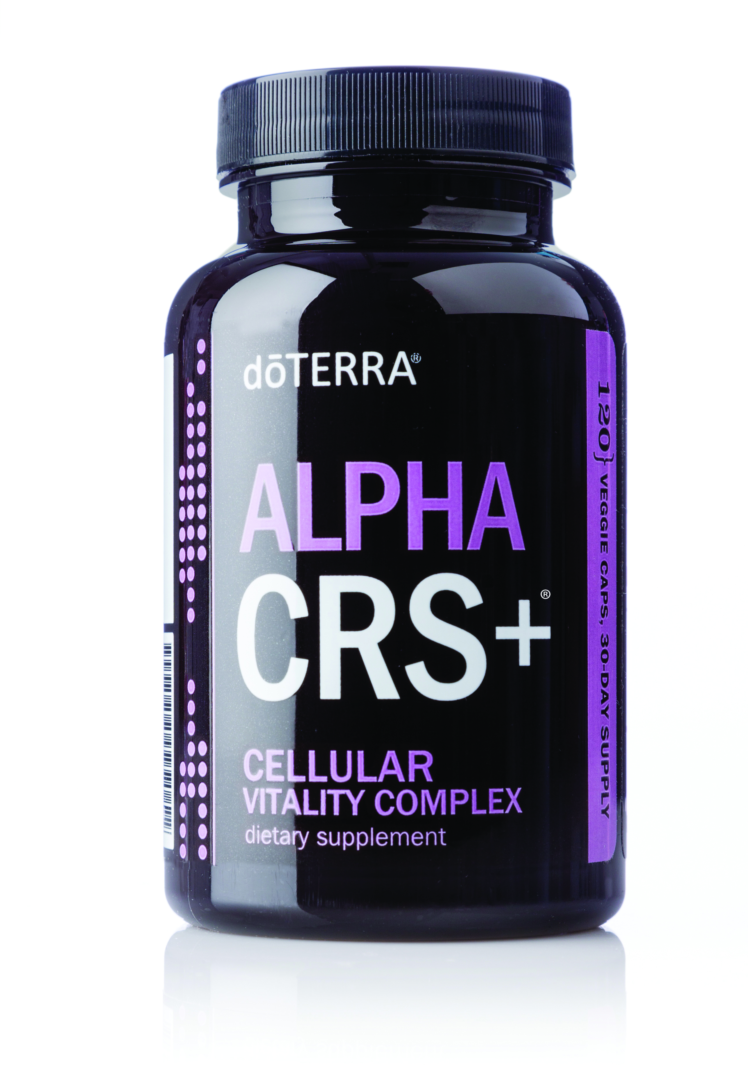
Alpha CRS®+
Alpha – a word that means “first”
CRS – an acronym for “Cellular Renewal System”
+ (plus) – added to emphasize improvements made to the original product
Notes:
Note: Discuss the text on the slide so that audience members understand what the name Alpha CRS+® stands for.
Let’s discuss the purpose, ingredients, and benefits of Alpha CRS+® to give you a better idea of why you would want to use this supplement as part of a healthy lifestyle.

Slide 2
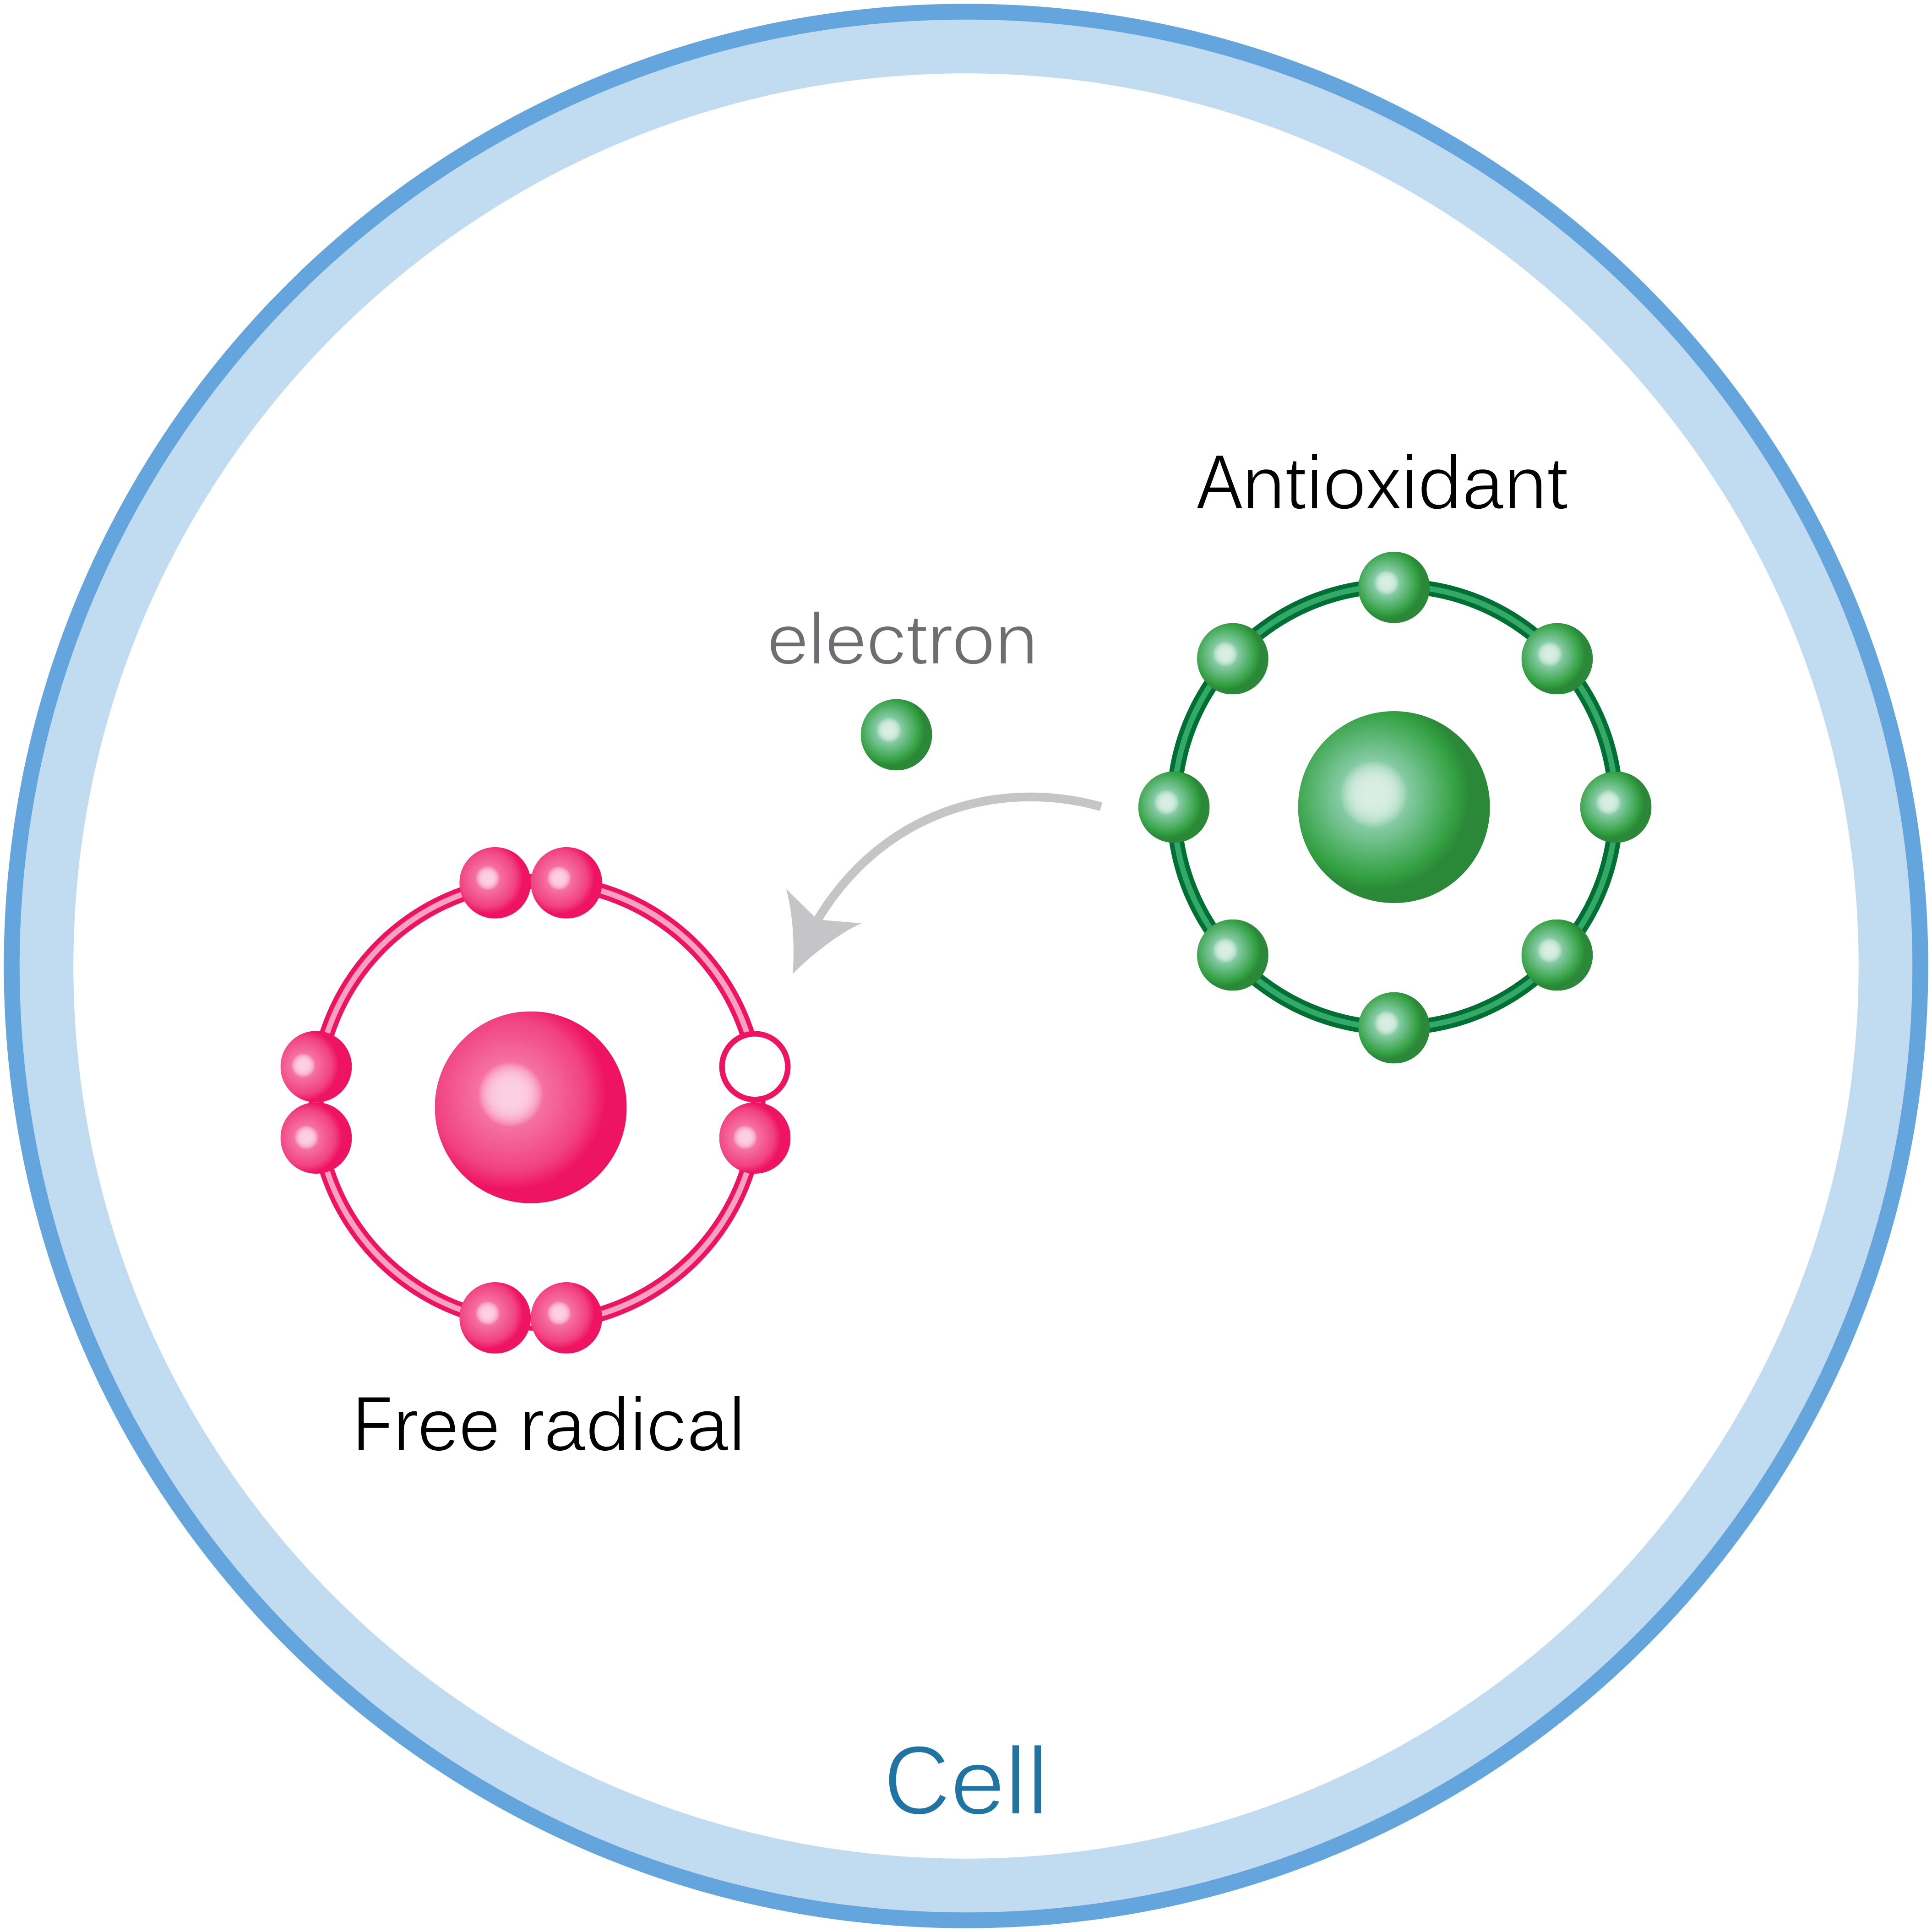
Alpha CRS®+ Purpose
Provide the body with antioxidants*
Promote vitality and improved energy levels*
DNA protection*
*These statements have not been evaluated by the Food and Drug Administration. This product is not intended to diagnose, treat, cure, or prevent any disease.
Notes:
PURPOSE
Provide the body with antioxidants
We have already discussed the importance of providing the body with antioxidants in order to protect the cells from damage by free radicals. Remember, free radicals are unstable molecules that can damage and even destroy healthy cells which speeds up the aging process, while antioxidants are stable molecules that are known to neutralize free radicals. Antioxidants can help protect cellular DNA and other cell structures from damage, which helps promote healthy aging. In addition to helping protect our cells from free radicals, antioxidants can help keep the heart, cardiovascular system, brain, and nervous system functioning properly.*
Alpha CRS®+ provides a healthy source of antioxidants for the body, which promote lifelong health and vitality.* Antioxidants can be found in many natural whole foods; however, it can be difficult to get adequate amounts of antioxidants on a daily basis from diet alone. By providing the body with antioxidants, Alpha CRS+ aims to provide cellular support and vitality in order to promote healthy aging.*
Promote vitality and improved energy levels
The health status of our cells can often determine the health of other parts of the body, including tissues and organs. Because energy production is a part of healthy cellular function, we can feel decreased energy and performance as we age, because this is when our cellular function typically begins to deteriorate.
Alpha CRS+ provides cells with essential nutrients and protection from toxic stressors (like free radicals) in order to promote healthy cellular function.* Helping cells function properly supports healthy energy production, which can translate to vitality and wellness.* If you’ve experienced feelings of decreased energy over the years, Alpha CRS+ can be used to promote healthy energy levels by protecting cells during the aging process.*
DNA protection
Another way to promote healthy cellular function is to protect cellular DNA, which regulates all activity within and between cells. DNA is found in the nucleus of each cell, and helps regulate the communication and activity that goes on among the millions of cells in our bodies. A healthy cell is supposed to reproduce, perform several specialized functions, and self-destruct when it is no longer useful in order to make room for new, healthy cells. When cellular DNA and other cell structures are damaged, the process of cell reproduction, function, and renewal can get derailed.

Slide 3
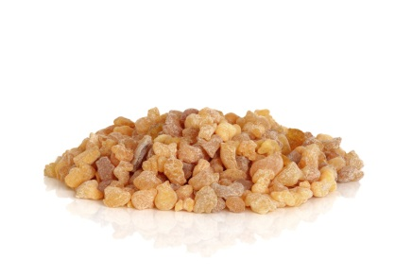
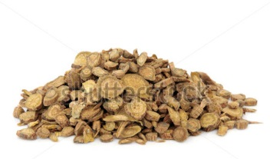
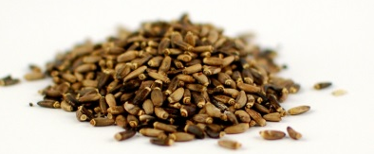
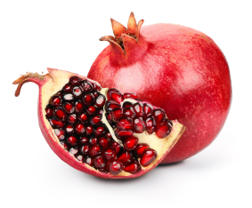
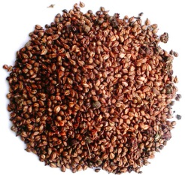
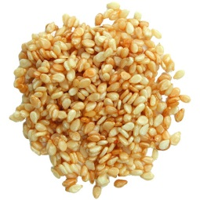
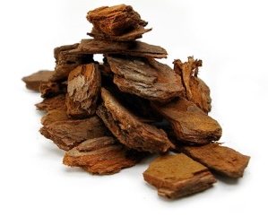
Alpha CRS®+ Ingredients
Boswellia Serrata
Baicalin
Milk Thistle
Resveratrol
Green Tea Leaf
Pomegranate
Pineapple
Turmeric
Grape Seed
Sesame Seed
Pine Bark
Notes:
The Alpha CRS+ formula includes a cellular longevity polyphenol blend, which aims to do as the name suggests—prolong the longevity or lifespan of cells with the use of polyphenols.* Remember, polyphenols can be described as a powerful group of antioxidants that are known to protect cells against free radical damage. Free radicals have the potential to damage cellular DNA, mitochondria (molecules that produce chemical energy), and other important cell structures, but consuming antioxidants like polyphenols can help protect cells and cell structures.*
Other ingredients include:
Boswellic acid and bromelain protease enzyme—supports healthy cellular function*
Botanical extract of Ginko biloba—supports mental clarity and energy*
Tummy tamer blend of botanical extracts—helps prevent stomach upset*
The Alpha CRS®+ formula is placed in sodium lauryl sulfate-free vegetable capsules

Slide 4
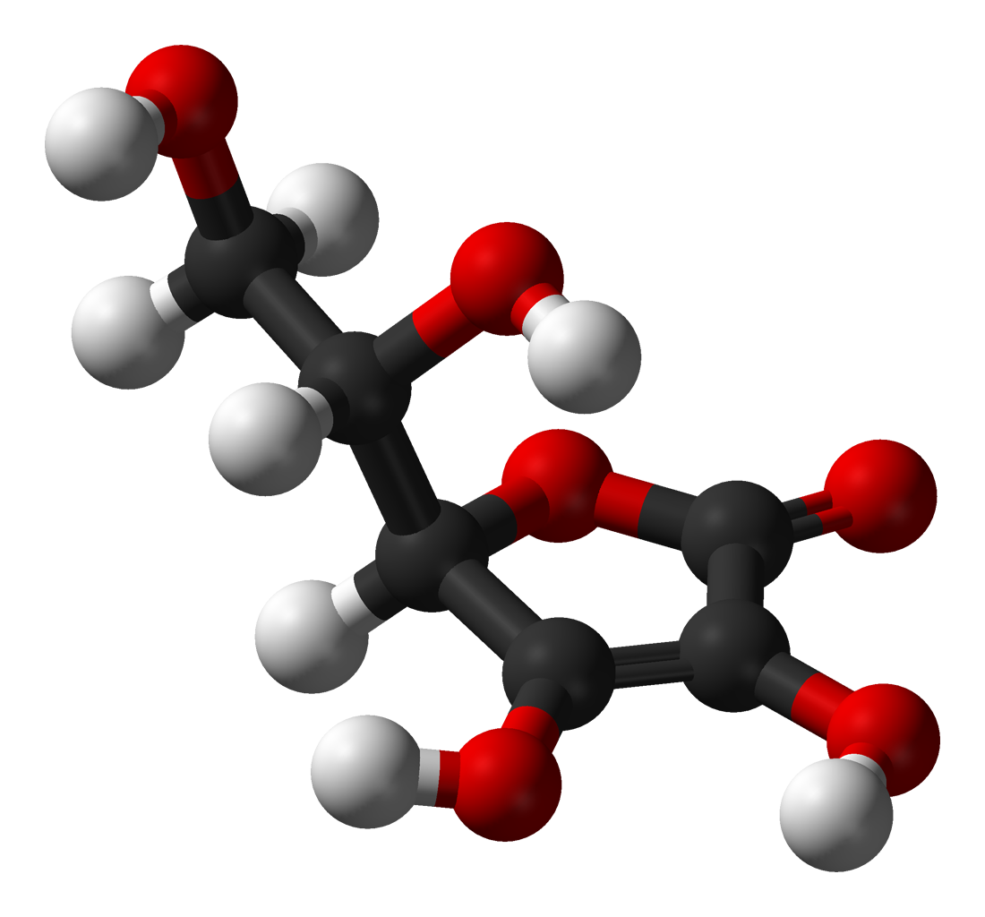
Alpha CRS®+ Benefits
Supports healthy cell function by protecting cellular DNA*
Promotes cellular energy by supporting healthy mitochondria*
Supports healthy cellular immune function*
Supports mental clarity and brain function*
*These statements have not been evaluated by the Food and Drug Administration. This product is not intended to diagnose, treat, cure, or prevent any disease.
Notes:
Using a proprietary blend of natural extracts and other ingredients, the Alpha CRS®+ formula can help combat the effects of aging on cellular health and energy and vitality levels. The list on this slide provides a look at the benefits that can come from using Alpha CRS®+ on a daily basis in conjunction with other healthy habits.

