Slide 1
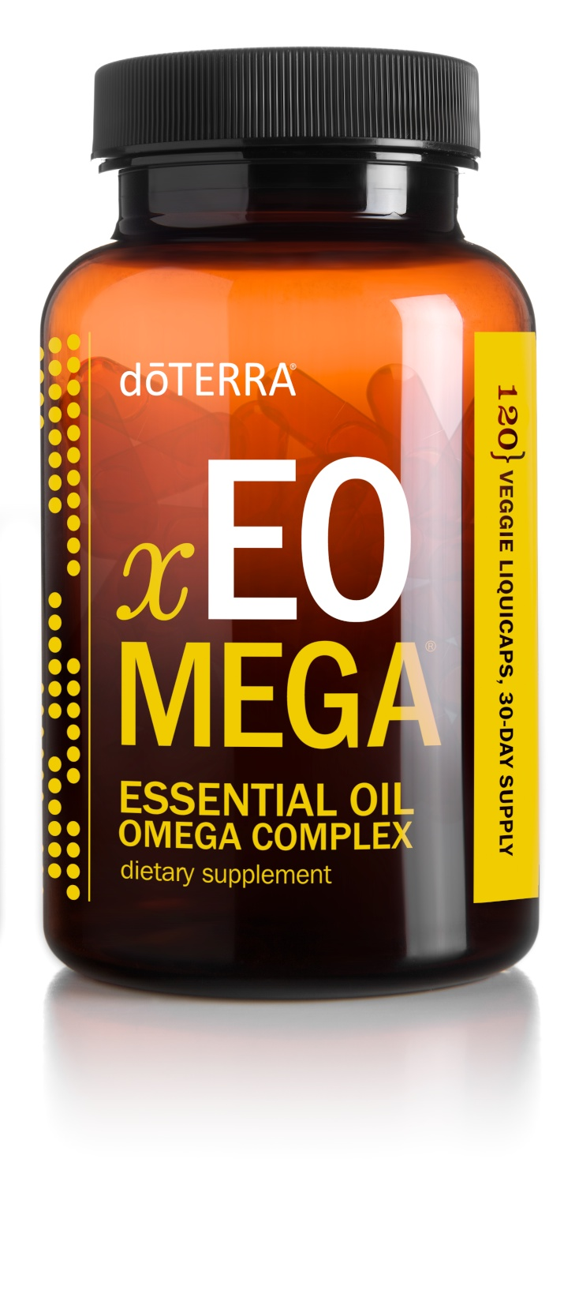
xEO Mega ®
x – stands for astaxanthin, a standardized extract of microalgae used in the xEO Mega formula
EO – stands for “essential oil”, CPTG® essential oils are an important ingredient in xEO Mega
Mega – represents the omega benefits provided by this complex
Notes:
Note: Discuss the text on the slide so that audience members understand what the name xEO Mega® stands for.

Slide 2
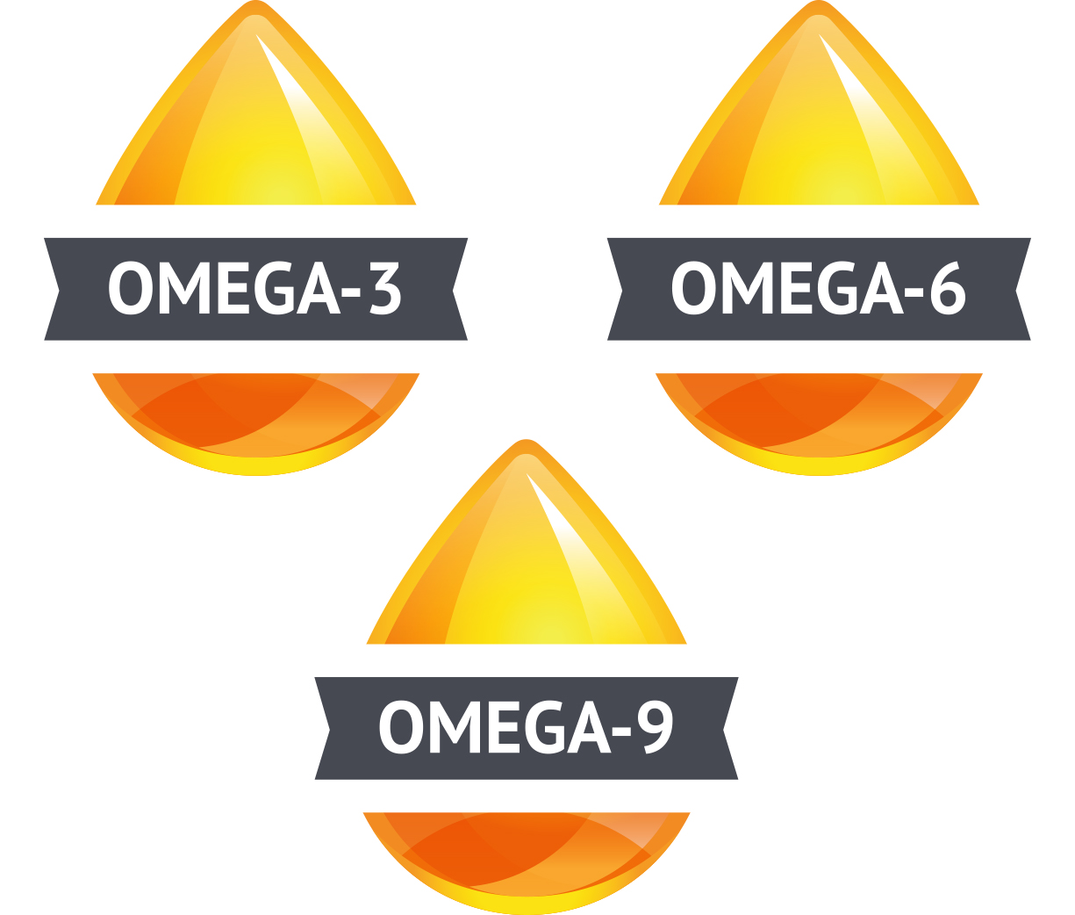
xEO Mega ® Purpose
Provide the body with essential fatty acids to help it function in a healthy way*
*These statements have not been evaluated by the Food and Drug Administration. This product is not intended to diagnose, treat, cure, or prevent any disease.
Notes:
While the Alpha CRS+® formula aims to provide the body with antioxidants and cellular protection, the xEO Mega® Essential Oil Omega Complex is designed to offer the body Essential Fatty Acids (EFAs) that will help the systems of the body function in a healthy way.* The body requires essential fatty acids to help with key functions like cell growth, brain development, muscle activity, immune function, joint health, and more.*
Fatty acid sources
Some fatty acids are produced naturally inside the body; however, essential fatty acids cannot be produced within the body, and must be obtained through the diet. While there are several types of essential fatty acids, the most common are omega-6 and omega-3 fatty acids. Although it is possible to provide the body with these essential fatty acids through the food we eat, the typical modern diet usually contains too much of the omega-6 fatty acids in the form of vegetable oils and hydrogenated or trans fats. While we do want some omega-6 fatty acids to provide our body with essential nutrients, consuming too much has been linked to poor health.
In contrast, there is scientific evidence suggesting that increasing dietary intake of omega-3 fatty acids can provide health benefits. Studies have shown that some of these health benefits include positive effects on cardiovascular health, brain function, immune function, joint health and mobility, and the skin.*
To maintain a healthy body, it is important to keep a proper balance between omega-3 and omega-6 fatty acids by decreasing dietary intake of foods that are high in omega-6 fatty acids and increasing intake of foods with omega-3 fatty acids. Omega-3 fatty acids can come from fatty fish, canola and olive oil, and the oils of some nuts and seeds. The xEO Mega complex is designed to provide the body with the proper balance of essential fatty acids using a unique blend of marine- and land-sourced fatty acids and other plant-based ingredients.

Slide 3
xEO Mega ® Ingredients
Marine and plant omega blend
Natural vitamins D and E
Astaxanthin
Essential oil blend: Clove, Frankincense, Thyme, Cumin, Wild Orange, Peppermint, Ginger, German Chamomile
*These statements have not been evaluated by the Food and Drug Administration. This product is not intended to diagnose, treat, cure, or prevent any disease.
Notes:
The dōTERRA® xEO Mega® Essential Oil Omega Complex contains a propriety blend of CPTG® essential oils, marine- and land-sourced omega fatty acids, and plant-based ingredients to provide the body with a number of benefits.
As discussed, some fatty acids are produced naturally inside the body, while some must be obtained from diet. It is possible to provide our body with the levels of omega-3 fatty acids through sources like canola oil, oil from nuts and seeds, and fish. However, many people are increasingly concerned about the level of toxins and heavy metals that are found in our oceans, so daily fish consumption is not an option that everyone is comfortable with. Some nutritional experts even warn against eating fish too frequently in order to protect the body against exposure to toxic pollutants. Thankfully, the xEO Mega formula contains marine- and land-sourced omega fatty acids to help provide the body with the proper balance of essential fatty acids and the benefits they offer.
Each serving of xEO Mega contains pure, micro-filtered marine lipids, which provide high levels of fatty acids. In addition to marine sources, the xEO Mega formula provides useful fatty acids with the inclusion of pomegranate seed oil and Echium seed oil.
Main ingredients:
Marine and plant omega blend: Concentrated, pure fish and echium seed oils providing useful fatty acids
Natural vitamins D and E: xEO Mega includes 800 IU (international units) of natural vitamin D and 60 IU of natural vitamin E. Vitamin D plays an essential role in bone health and growth, and can help promote healthy immune function as well as a healthy response to cellular stress.*
Astaxanthin: a powerful antioxidant carotenoid harvested from microalgae. Astaxanthin is coupled with natural vitamin E to provide circulatory and systemic benefits, as well as powerful antioxidants.*
Essential oil blend
The essential oil blend used in xEO Mega provides the body with antioxidants to promote healthy cells.* Using essential oils in the xEO Mega formula also helps protect the essential fatty acids used in the formula from oxidation and rancidity, as the oils act as a natural preservative system. The xEO Mega formula includes a proprietary blend containing the following essential oils: Clove, Frankincense, Thyme, Cumin, Wild Orange, Peppermint, Ginger, German Chamomile
The xEO Mega® formula is encapsulated in convenient, vegetarian-friendly softgels

Slide 4
xEO Mega ® Benefits
Promotes heart and circulatory health*
Supports healthy joint function and comfort*
Provides immune-boosting nutrients*
Supports healthy function of the brain, eyes, and nervous system*
Promotes healthy skin*
The use of CPTG® essential oils provides antioxidants, supports healthy cellular responses, healthy immune function, and digestive calming effects.*
Provides a wide range of omega-3 fatty acids from marine and plant sources to help maintain a healthy balance of these vital nutrients*
Astaxanthin provides the body with antioxidants as well as systemic and circulatory benefits*
Provides the body with natural sources of vitamin D and E
Notes:
As you can see, the combination of powerful ingredients and essential oils in the xEO Mega® formula make it a useful supplement for providing the body with a healthy balance of essential fatty acids, along with other benefits.
Note: Read through the benefits listed on this slide so that audience members can get a better idea of the overall benefits xEO Mega has to offer.

Slide 5
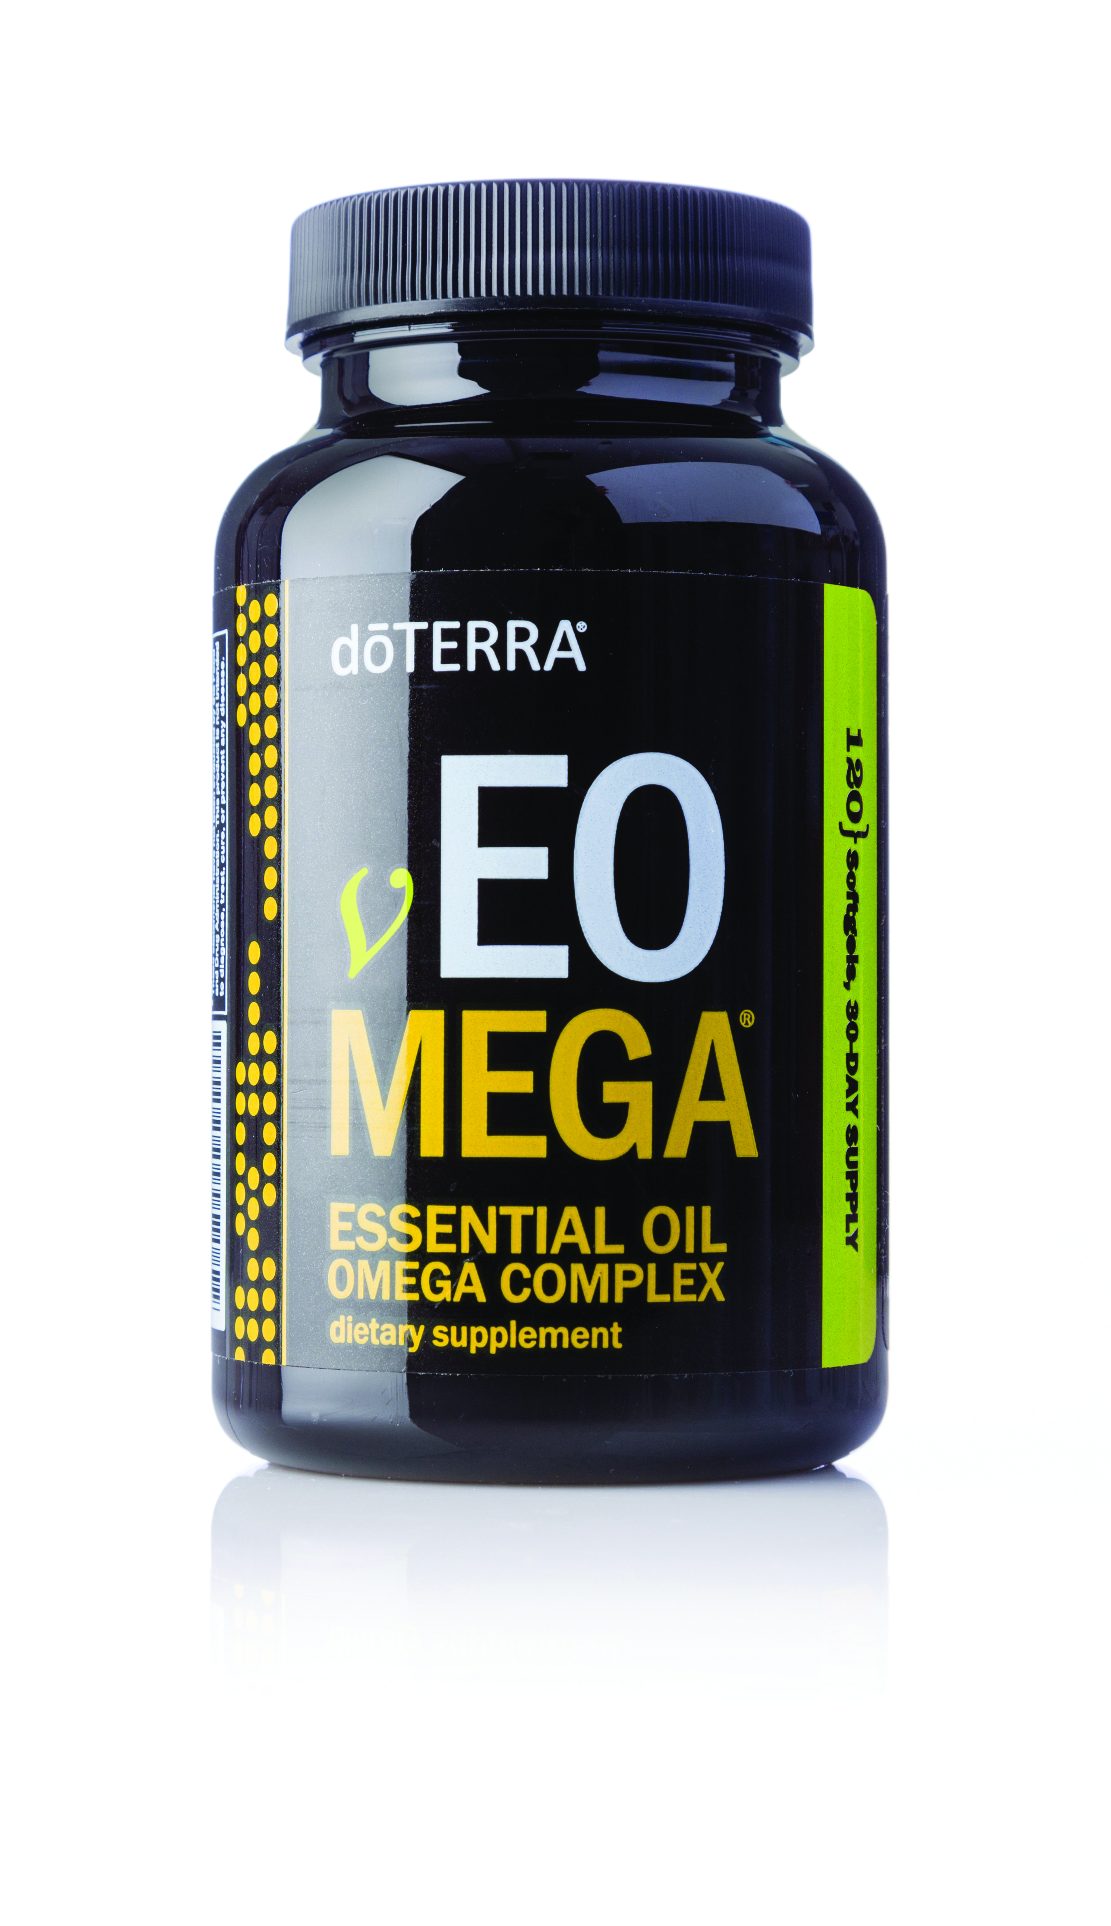
vEO Mega®
Notes:
For those who do not wish to consume fish- or marine-based products due to diet restrictions or personal preferences, dōTERRA has created vEO Mega®. Alpha CRS®+ and Microplex VMz® are already considered vegetarian friendly, but the inclusion of the marine omega blend used in xEO Mega® does not allow it to be labeled as vegan. By creating vEO Mega, dōTERRA has made it possible for those who only wish to use products with vegetarian ingredients to still provide their bodies with essential fatty acids.
Instead of using a blend of fish oils, the vEO Mega formula uses plant and algae-based sources to provide a unique blend of essential fatty acids. While the ingredients are slightly different than xEO Mega, the vEO Mega complex makes it easy for those who want to use vegetarian supplements to obtain essential fatty acid and omega benefits.

