Slide 1
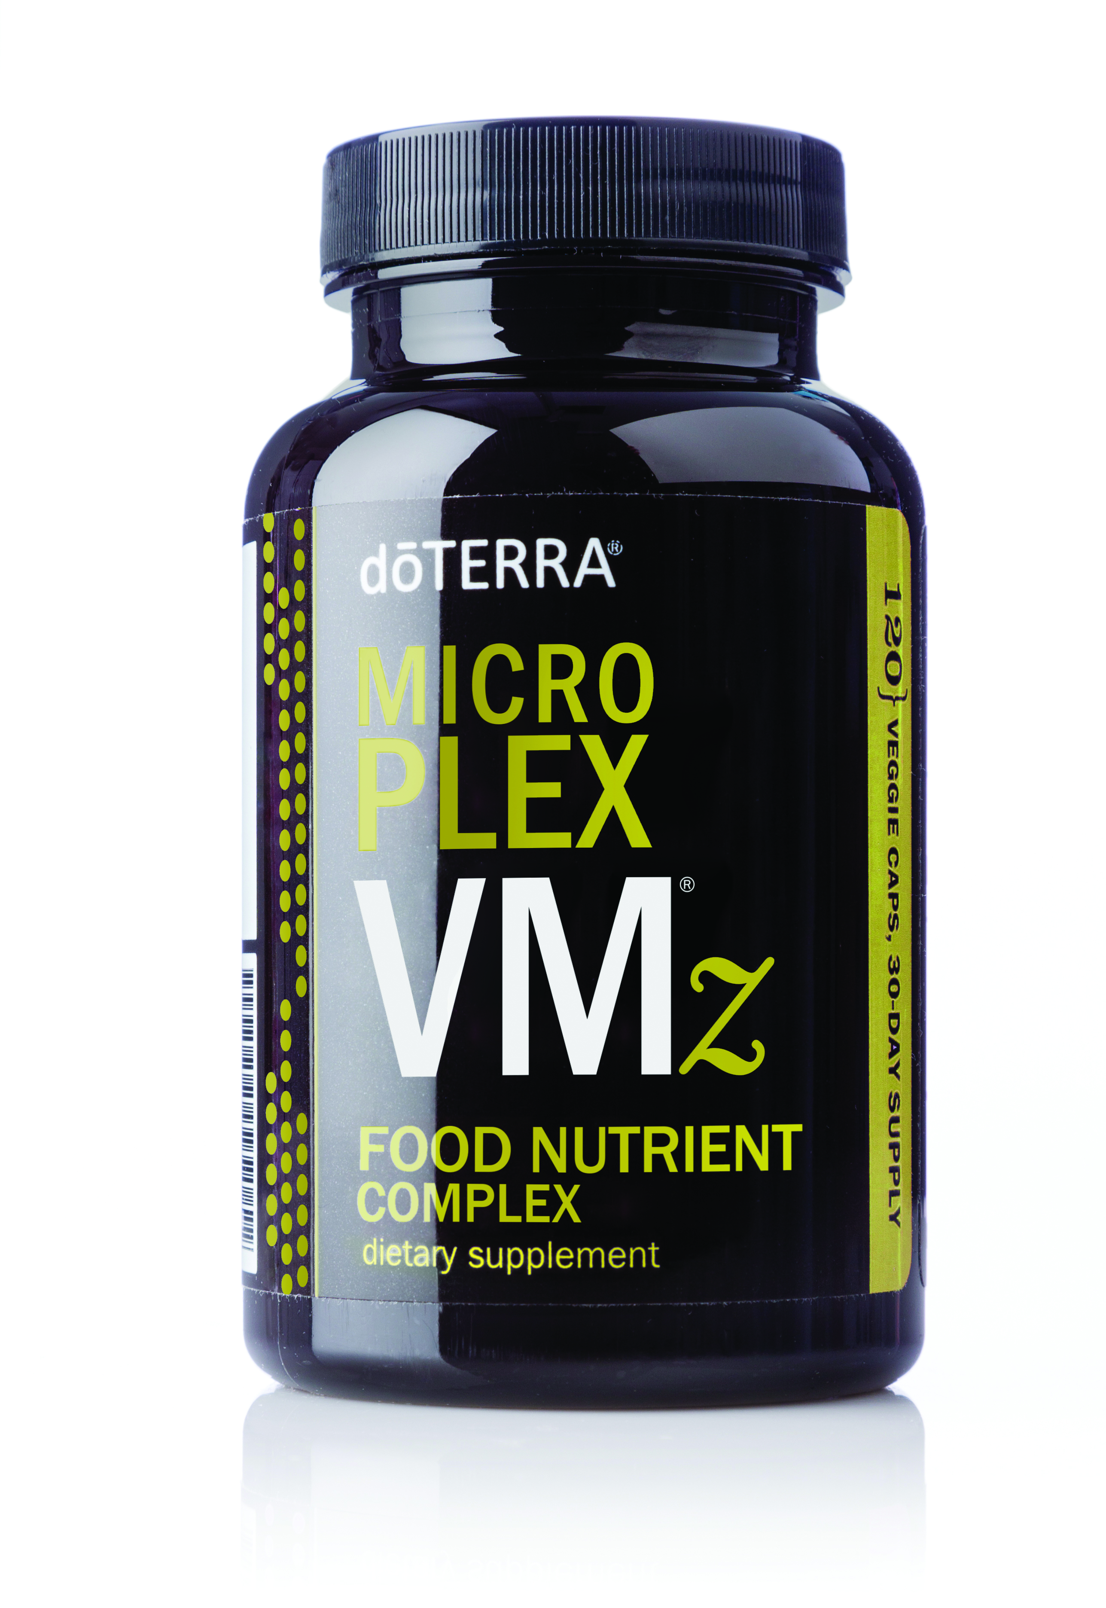
Microplex VMz ®
Microplex – a combination of the words “micronutrient” and “complex”
VM – stands for “vitamins” and “minerals”
z – represents improvements made to the original product
Notes:
Note: Discuss the text on the slide so that audience members understand what the name Microplex VMz® stands for.

Slide 2
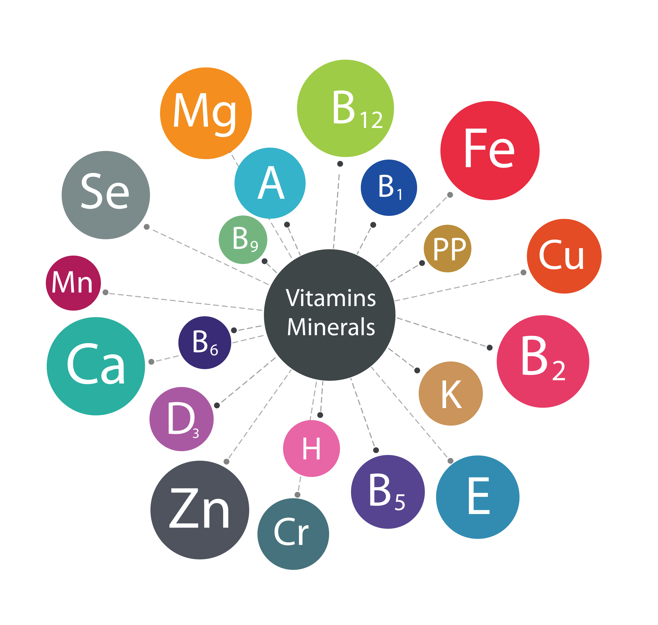
Microplex VMz® Purpose
Provide essential vitamins and minerals to keep the body functioning in a healthy manner*
Offer vitamins and minerals that we might not be getting in our diet
*These statements have not been evaluated by the Food and Drug Administration. This product is not intended to diagnose, treat, cure, or prevent any disease.
Notes:
In addition to antioxidants and essential fatty acids, our bodies need essential vitamins and minerals to keep all systems functioning in a healthy manner.* Essential vitamins and minerals cannot be produced in the body in sufficient quantities, so we must rely on our diet to provide the body with proper nutrients. Unfortunately, most modern diets are lacking a variety of vitamins and minerals, often resulting in nutritional deficiencies.
The Microplex VMz® Food Nutrient Complex is designed to provide us with adequate amounts of vitamins and minerals to promote optimum health, when combined with a well-balanced diet and healthy lifestyle.* By using Microplex VMz with xEO Mega® on a daily basis, we can help our bodies obtain the proper amount of vitamins, minerals, and omega fatty acids needed for good health.
Using a specialized formula, Microplex VMz aims to provide vitamins that are deficient in our modern diets, like vitamin A, C, E, and B.
The Microplex VMz formula also aims to give the body minerals like calcium, magnesium, and zinc, which can help promote bone and metabolic health.* We know from the Estimated Average Requirements (EAR) chart at the beginning of this presentation that more than 90 percent of American adults do not reach the daily requirements for vitamin E, and roughly half of Americans do not fulfill nutrient requirements for magnesium, vitamin A, calcium, and vitamin C. While it is possible to reach these requirements with a healthy diet, it’s easier said than done. Using Microplex VMz on a daily basis in conjunction with other healthy habits makes it possible to give the body an adequate amount of nutrients that it might be missing.

Slide 3
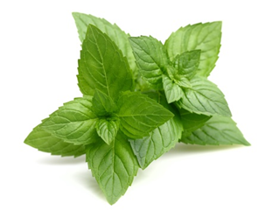
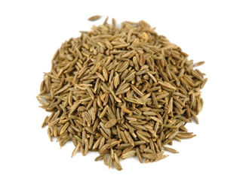
Microplex VMz® Ingredients
Balanced blend of essential vitamins and minerals
Whole food botanical blend
Enzymes to aid in digestion and help with absorption of nutrients*
dōTERRA® tummy tamer botanical blend
*These statements have not been evaluated by the Food and Drug Administration. This product is not intended to diagnose, treat, cure, or prevent any disease.
Peppermint
Ginger
Fennel
Notes:
Presented in a food nutrient complex, Microplex VMz provides a variety of vitamins and minerals that will help with the growth, function, and maintenance of cells.* The Microplex VMz formula provides a blend of antioxidant and energy complex vitamins, while also including minerals that are beneficial for metabolism and bone health.*
The patented Microplex VMz formula is also designed to promote bioavailability—which means that our bodies will recognize and absorb the vitamins, minerals, and food nutrients. Sometimes certain vitamins and minerals can be difficult for our body to recognize or absorb, so the Microplex VMz formula uses a special patented glycoprotein matrix to help with bioavailability. In addition, the formula also contains a blend of digestive enzymes and mineral cofactors to enhance digestion and help with the assimilation of nutrients.*
Balanced blend of essential vitamins:
Antioxidant vitamins A, C, and E*
Energy complex of B vitamins*
Natural vitamin D for enhanced bioavailability*
Whole food botanical blend: Kale, dandelion, parsley, kelp, broccoli, Brussels sprout, cabbage, and spinach
Enzymes to aid in digestion and help with absorption of nutrients*: Protease, lactase, lipase, amylase, alpha-galactosidase, diatase, glucoamylase, peptidase
Balanced blend of essential minerals: Calcium, iron, iodine, magnesium, zinc, selenium, copper, manganese, chromium
dōTERRA® tummy tamer botanical blend: Peppermint Leaf, Ginger Root, and Caraway Seed extracts
Microplex VMZ uses sodium lauryl sulfate-free vegetable capsules and does not contain genetically modified material.

Slide 4
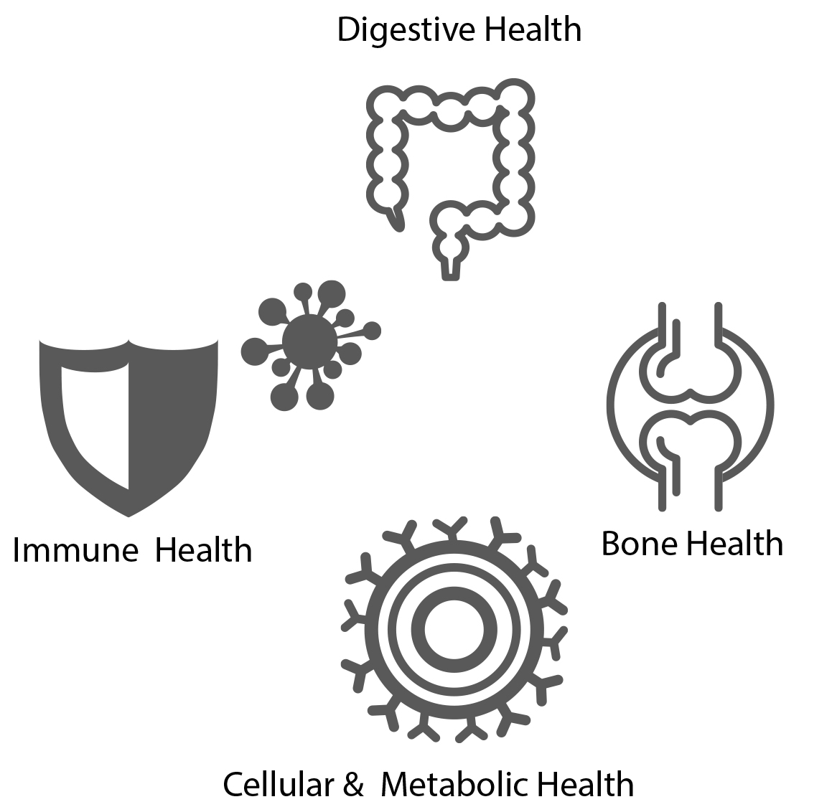
Microplex VMz® Benefits
Provides 22 essential vitamins and minerals to support normal growth, function, and maintenance of cells*
Fights free radicals with the antioxidant vitamins A, C, and E*
Supports healthy metabolism and cellular energy*
Supports bone health with calcium, magnesium, zinc, and vitamin D*
Supports healthy immune function*
Supports healthy digestion*
Includes a patented glycoprotein matrix for enhanced bioavailability*
Notes:
Note: Read through each of the benefits on this slide to give audience members a review of each of the Microplex VMz® benefits.
With so many powerhouse ingredients and desirable benefits, it is easy to see why Microplex VMz® is a must-have product in the Lifelong Vitality Program.

Slide 5
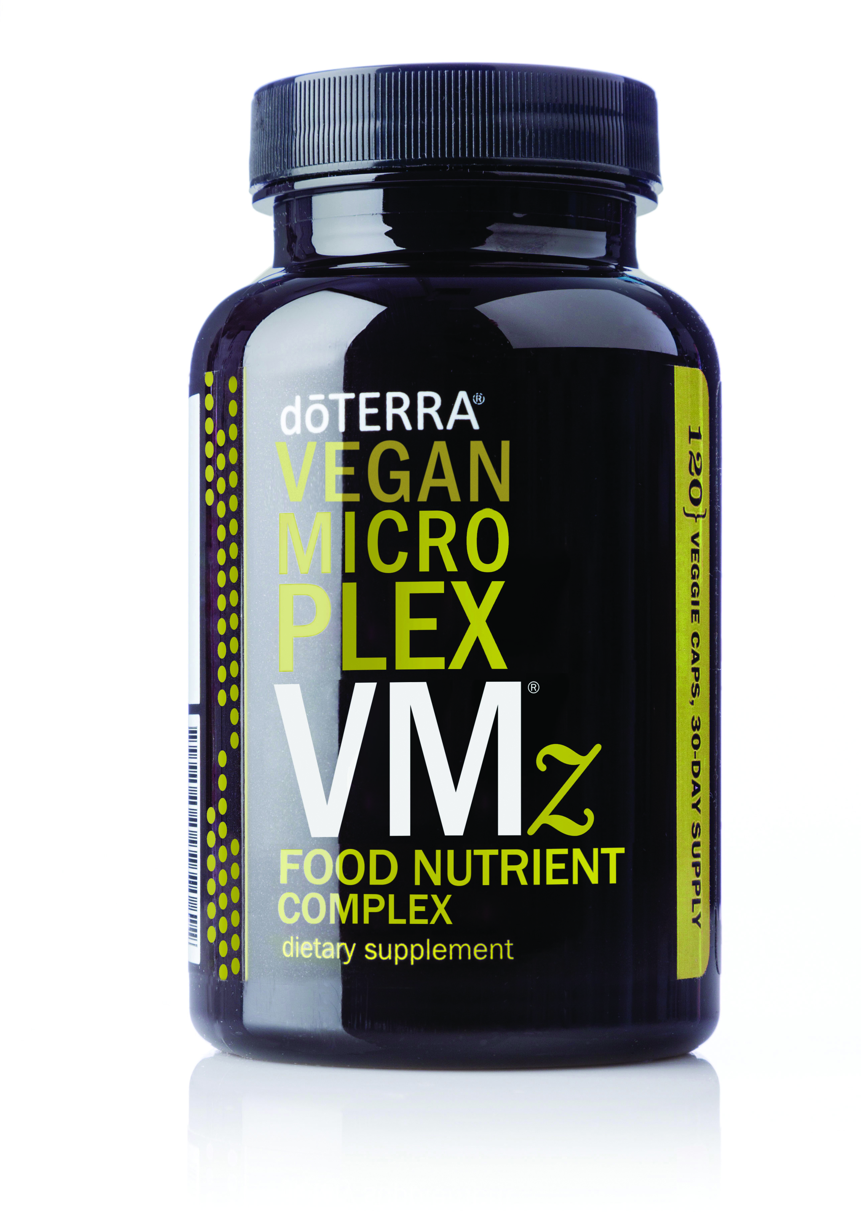
Vegan Microplex VMz®
Notes:
Vegan Microplex VMz offers the same benefits of Microplex VMz, but is sourced from vegan-friendly sources. This complex still includes the vitamins and minerals found in the original Microplex VMz formula, as well as the dōTERRA tummy tamer blend, and a vegan-friendly patented glycoprotein matrix to help enhance bioavailability.* The Vegan Microplex VMz formula is encapsulated in sulfate-free vegetable capsules, and doesn’t contain any genetically modified material.

